Slide 1
Lecture 7: Radiation Detection
Dr. Guohua Cao （曹国华） caogh@shanghaitech.edu.cn
School of Biomedical Engineering
ShanghaiTech University
3/26/2024

Slide 2
Lecture 7: Radiation Detection
Introduction to Radiation Detector
Imaging Detector
Radiation Survey Detector
Dosimeter
Properties of Imaging Detectors
Field coverage
Fill factor
Readout speed
Uniformity
Dynamic range
Pixel size
Quantum efficiency
Sensitivity
Detector Electronic noise
Detector Anti-Scatter Grid

Slide 3
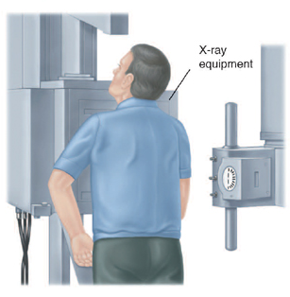
Radiation based imaging systems
Require:
1. radiation source
2. object
3. radiation detector
x-ray detector
x-ray source
Patient (object)
Notes:
Just like the imaging signal arises from x-ray object interaction, image detection is also based on x-ray and detector interaction, which can be thought as a subtopic of x-ray matter interaction. Here, the matters will be from a few limited choices only, as we will see later.

Slide 4
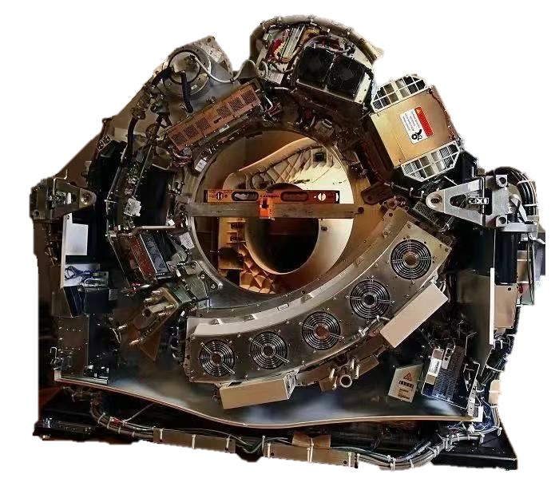
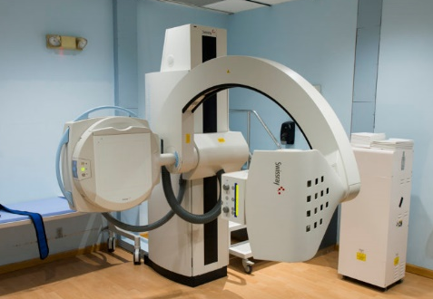
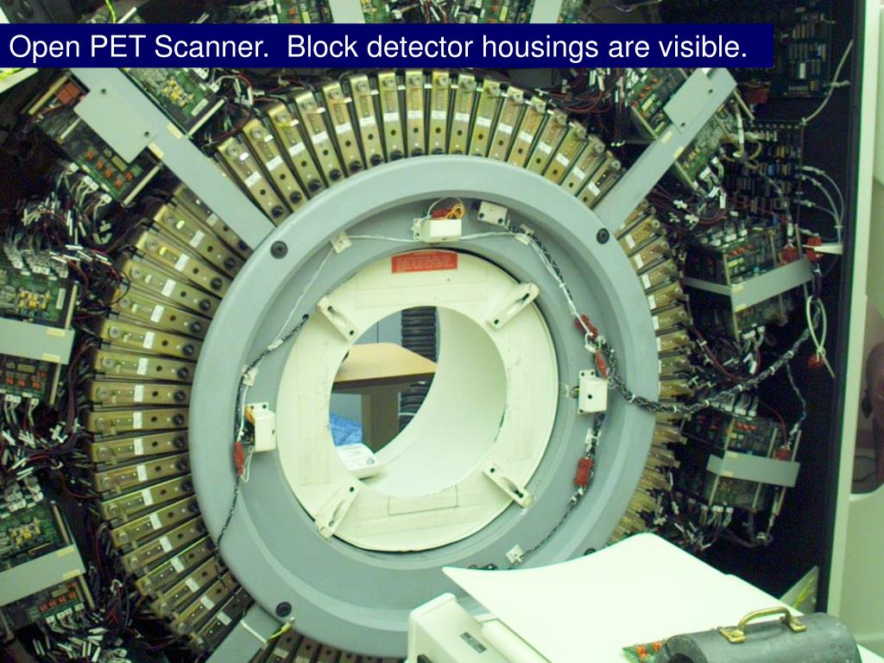
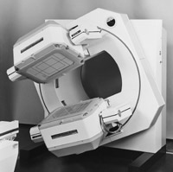
球管
X-ray
CT
探测器
PET
SPECT

Slide 5
Different types of detectors
Direct Type
DR (Digital Radiography) Detector
Indirect Type
Digital Detectors
Detectors
CR (Computed Radiography) Detector
Analog Detectors

Slide 6
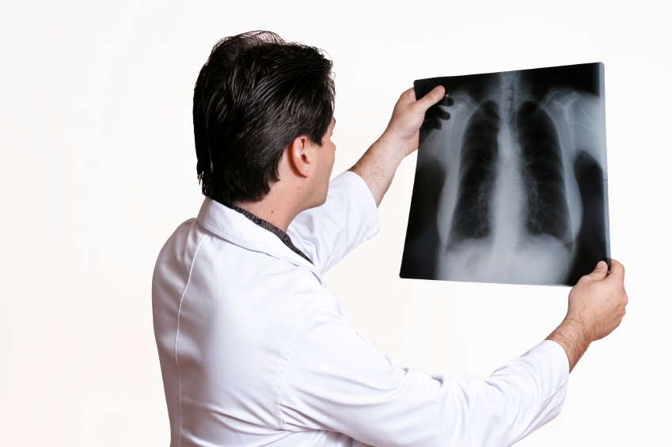
Analog vs. Digital Detectors
Analog
Digital
Output is a digital image (that is displayed on computer screen).
Output is a film.

Slide 7
Different types of detectors
Direct Type
DR (Digital Radiography) Detector
Indirect Type
Digital Detectors
Detectors
CR (Computed Radiography) Detector
Analog Detectors

Slide 8
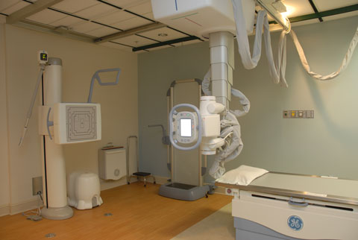
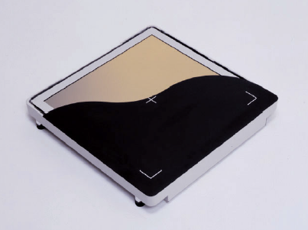
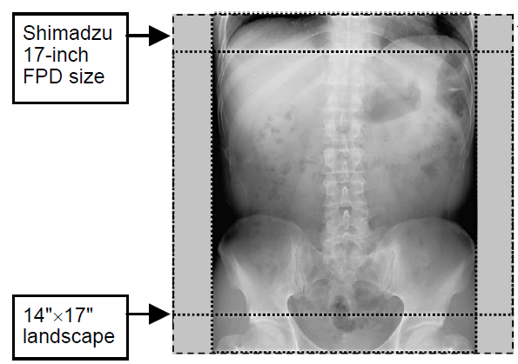
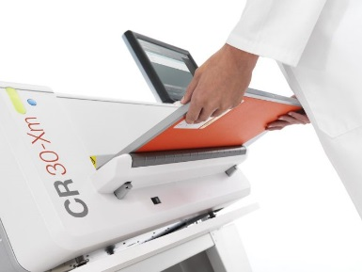
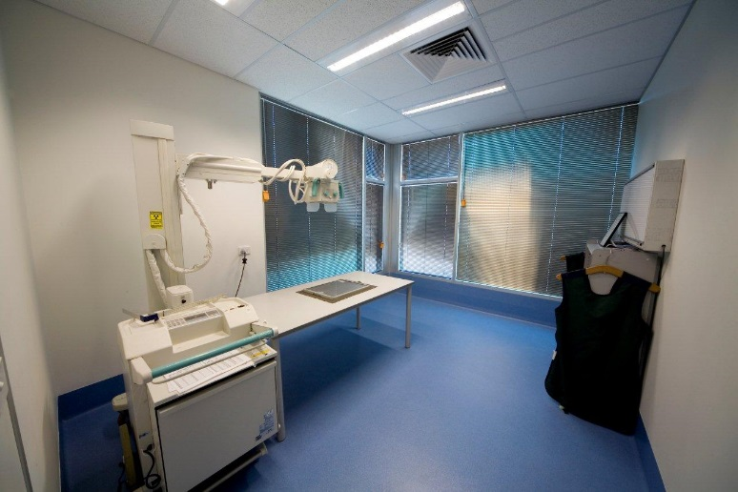
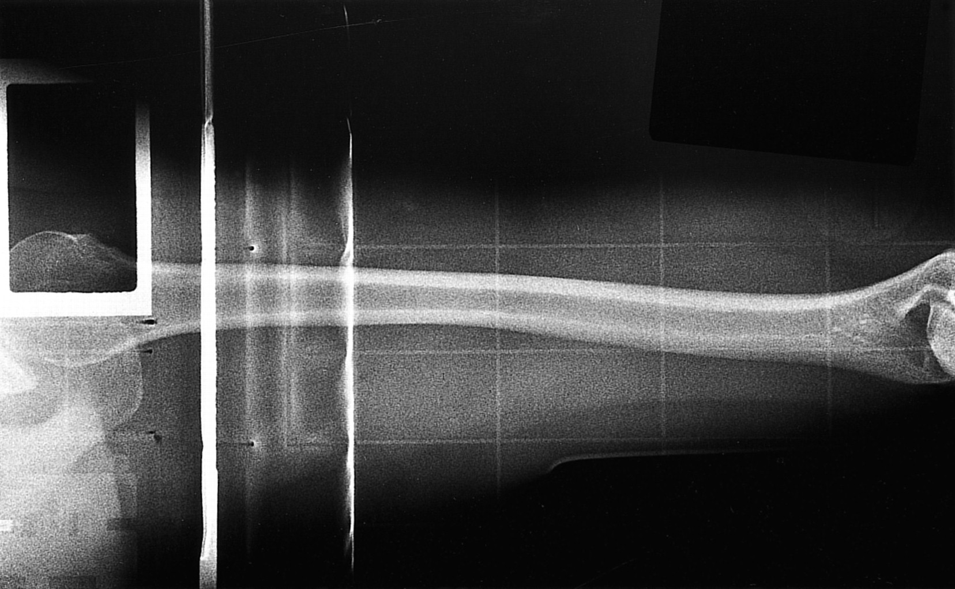
Digital Detectors
DR
CR

Slide 9
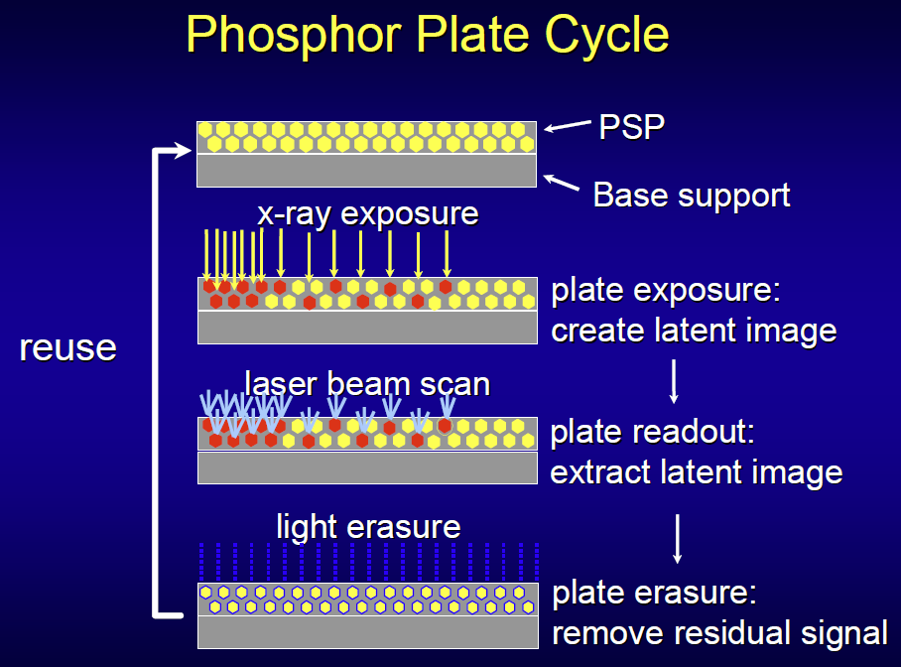
Computed Radiography Detectors
(PSP=Photostimulable Plate)
1. X-rays strike PSP.
2. PSP release electrons.
3. Electrons are trapped in phosphor crystal lattice for hours.

Slide 10
CR vs. DR
Computed Radiography
Direct Radiography
Photostimulable phosphor plate
CR reader
Image is temporarily stored in a CR plate and then digitized by a CR reader.
Digital (direct or indirect) x-ray detector
Digital image output
Digitized analog x-ray imaging
Digitized x-ray imaging

Slide 11
Different types of detectors
Direct Type
DR (Digital Radiography) Detector
Indirect Type
Digital Detectors
Detectors
CR (Computed Radiography) Detector
Analog Detectors

Slide 12
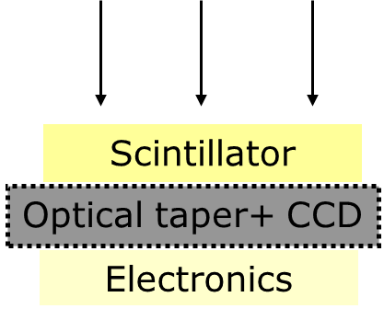
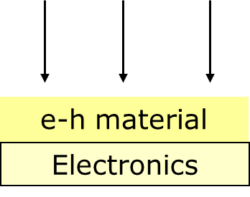
DR (Digital Radiography) Detectors
Direct
Indirect
X-rays → Voltages
X-rays → Optical Lights → Voltages

Slide 13
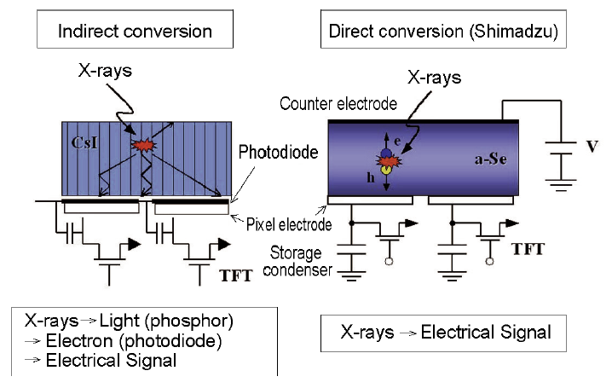
DR: Direct & Indirect X-ray Detectors
Indirect:
X-rays are converted to optical photons at CsI scintilattor layer. The optical photons are then converted to electrons by photodiodes. Those electrons then get detected as electrical signals by readout electronic circuit.
Direct:
X-rays create e-h pairs at a-Si layer. The electrons migrated toward the positive end of the bias voltage. Those electrons then get detected as electrical signals by readout electronic circuit.
Notes:
Direct x-ray detectors seem winning over the indirect x-ray detectors

Slide 14
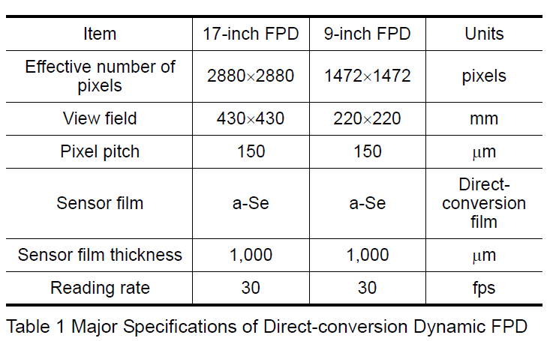
Direct Detector
Shimadzu 17” FPD (Flat Panel Detector)

Slide 15
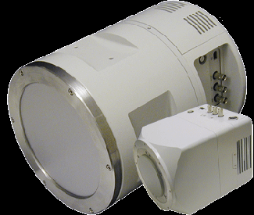
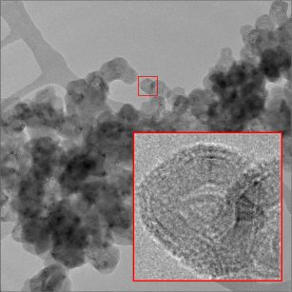
CCD-based indirect x-ray camera – optically coupled CCD system
Princeton Quad-RO
4096x4096/16M matrix size
15x15 um^2 pixel size
Not FPD
optical lens to focus optical photons, with focusing ratio R > 1.
High-res imaging of CNTs

Slide 16
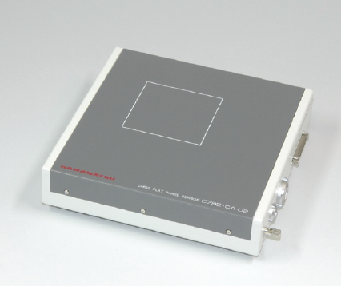
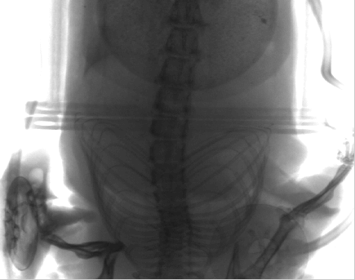
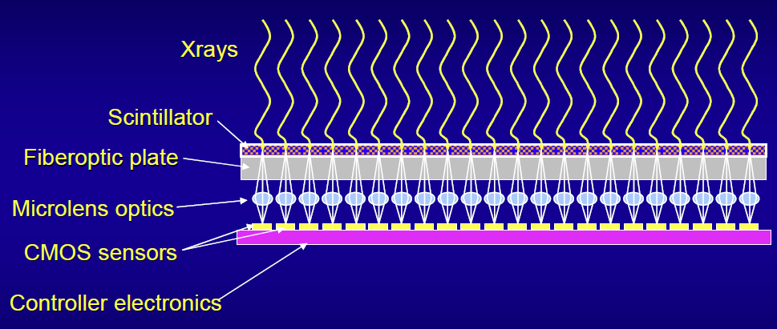
Another Indirect Detector – Photodiode-array-based CMOS sensor
Hamamatsu FPD

Slide 17
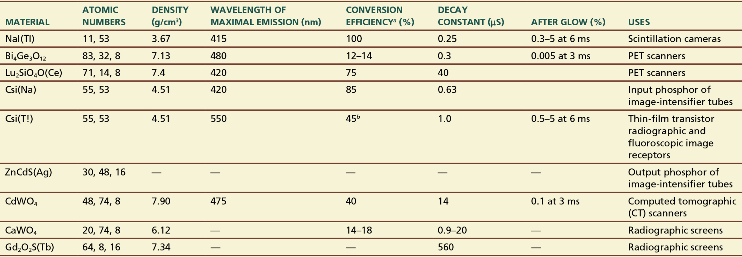
Scintillator
Scintillators are materials that emit visible light or UV radiation after the interaction of ionizing radiation with the material.
Roentgen discovered x-radiation and the fact that x-rays induce scintillation in barium platinocyanide
A scintillation detector consists of a scintillator and a device, such as a PMT, that converts the light into an electrical signal.

Slide 18
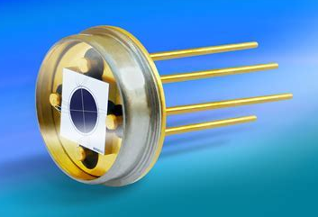
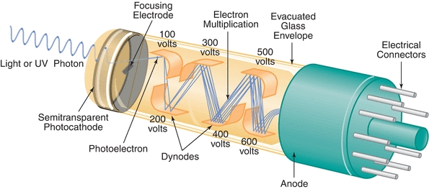
Conversion of Light into Electrical Signal
Photodiodes
PMT (Photo-Multiplier Tube)
Photodiodes are semiconductor diodes that convert light into electrical signals.
6 dynodes, each dynode has amplification factor of 5
Total amplification factor = 5^6 = 15,625
Notes:
https://www.teamwavelength.com/photodiode-basics/

Slide 19
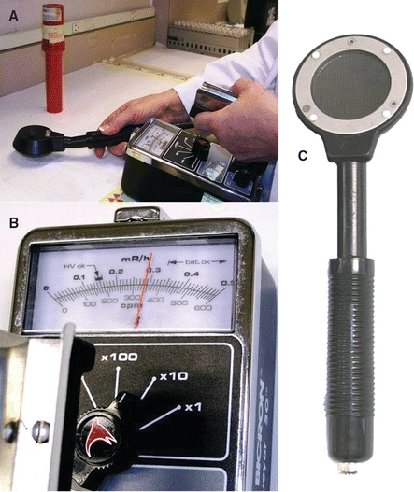
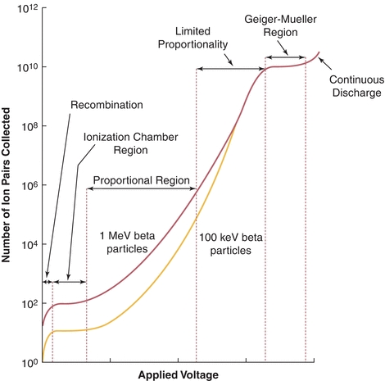
Survey Meter: Geiger-Mueller Counters
In pulse mode, the signal from each interaction is processed individually.
In current mode, the electrical signals from individual interactions are averaged together, forming a net current signal.
Operated in Pulse Mode
Good for surveying radioactive contamination
Pancake probe
Notes:
Air kerma is the initial kinetic energy transferred to charged particles, in this case electrons liberated in air by the radiation, per mass air and exposure is the amount of electrical charge created in air by ionization caused by these electrons, per mass air.

Slide 20
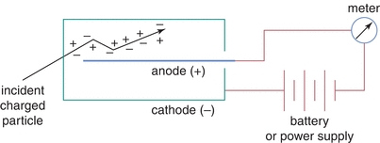
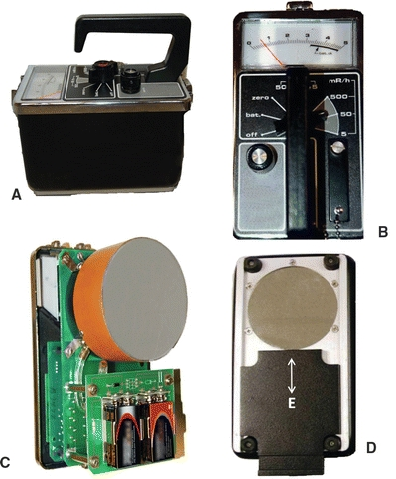
Survey Meter：Ionization Chambers
Gas-filled detector
Operated in Current Mode
Good for measuring exposure rate from 0.1 mR/h to 50 R/h
A charged particle, such as a beta particle, is shown entering the detector from outside and creating ion pairs in the gas inside the detector. This can occur only if the detector has a sufficiently thin wall. When a thick-wall gas-filled detector is used to detect x-rays and γ-rays, the charged particles causing the ionization are mostly electrons generated by Compton and photoelectric interactions of the incident x-rays or γ-rays in the detector wall or in the gas in the detector.

Slide 21

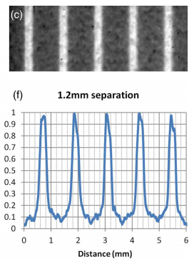
Dosimeter
Thermoluminescent Dosimeter (TLD)
Film-based Dosimeter
Lithium fluoride (LiF) is one of the most useful TLD materials.
It is a scintillator with trapping of excited electrons after radiation.
The trapped electrons can be released by heating.
the electrons then fall to their ground state with the emission of light, which can be detected by a PMT or other sensor.
The amount of light emitted by the TLD increases with the amount of energy absorbed by the TLD, but may deviate from proportionality, particularly at higher doses.
After the TLD has been read, it may be baked in an oven to release the remaining trapped electrons and reused.

Slide 22
Imaging Detector Properties
Field coverage
Fill factor
Readout speed
Uniformity
Dynamic range
Pixel size
Quantum efficiency
Sensitivity
Detector Electronic noise

Slide 23
Detector Properties
Field coverage – physical size of the active sensor
Fill factor – fraction of the detector area that is responsive to the incident x-rays (i.e., not dead)
Readout speed – period of time that is needed to transfer projection data to a storage device
Uniformity – degree of variability among performance of all the pixels across the entire area of the detector

Slide 24
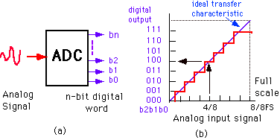
Signal Sampling: dynamic range
For ADC (Analog-to-Digital Converter),
Dynamic Range specifies the number of different values that the output of the ADC can have.
Sampling Resolution equals the voltage range of the ADC divided by 2^N, where N is the bit-depth of the ADC.
Quantization Error is the difference between the true analog input signal and the digitized output.

Slide 25

X-ray Detector Dynamic Range
Dynamic range (DR) is the ratio between the largest and smallest possible values of a changeable quantity. It is measured as a ratio.
$DR=\frac{X_{max}}{X_{noise}}$
where Xmax is the x-ray fluence providing the maximum signal that the detector can accommodate and Xnoise is the x-ray fluence that provides a signal equivalent to the imaging noise (i.e. SNR=1, where the imaging noise includes both the detector noise and the x-ray quantum noise.)
Dynamic range, contrast ratio, and bit depth of ADC (Analog-to Digital Converter):
Bit Precision of ADC | Contrast Ratio | Dynamic Range
8 | 256:1 | Remain the same
10 | 1024:1
12 | 4096:1
14 | 16384:1
16 | 65536:1
Notes:
http://www.ncbi.nlm.nih.gov/pubmed/14596297

Slide 26
Effect of sampling resolution with diff. bit-depth

Slide 27
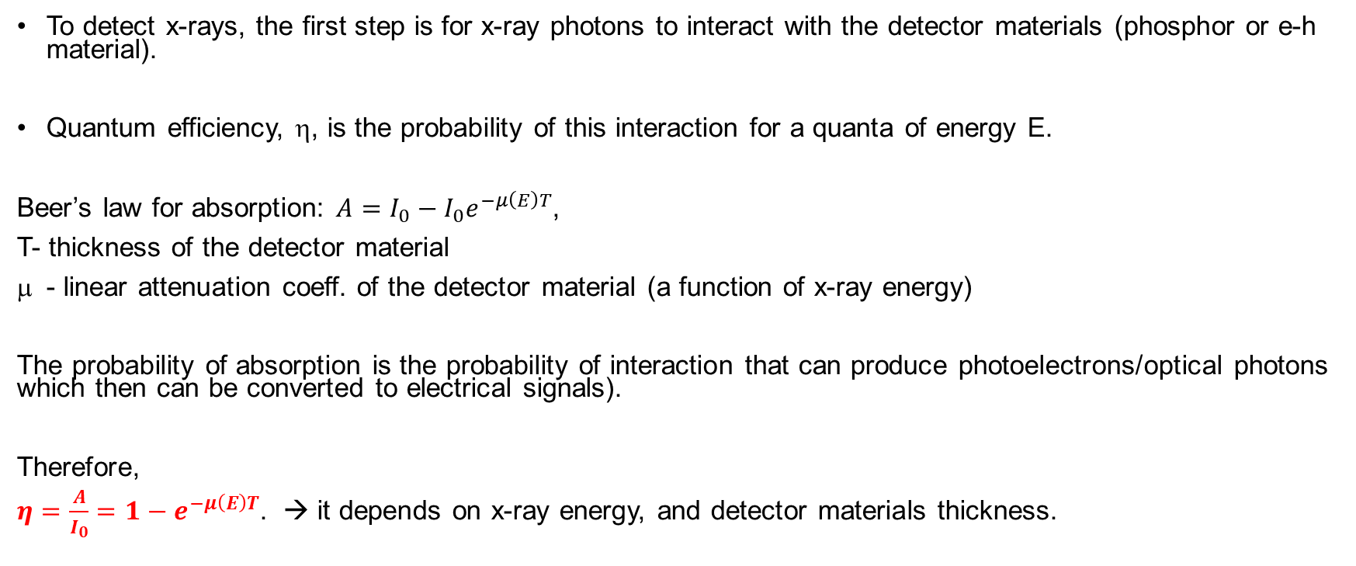
Quantum Efficiency
To detect x-rays, the first step is for x-ray photons to interact with the detector materials (phosphor or e-h material).
Quantum efficiency, η, is the probability of this interaction for a quanta of energy E.
Beer’s law for absorption: $A=I_{0}−I_{0}e^{−μ\left(E\right)T}$,
T- thickness of the detector material
- linear attenuation coeff. of the detector material (a function of x-ray energy)
The probability of absorption is the probability of interaction that can produce photoelectrons/optical photons which then can be converted to electrical signals).
Therefore,
$η=\frac{A}{I_{0}}=1−e^{−μ\left(E\right)T}$. → it depends on x-ray energy, and detector materials thickness.

Slide 29
Sensitivity
Sensitivity is the charge produced by the detector (before any external amplification)
per incident x-ray quantum of a specified energy.

Slide 30
Detector Properties
Field of view (FOV)
The size (in mm²) of active sensor in a detector
Pixel size
E.g. 0.5mm pixel size in a typical CT detector
Quantum efficiency
>90% for most x-ray detectors
Detector noise

Slide 31
Detector Electronic Noise
Electronic noise is a random fluctuation in an electrical signal. It is a characteristic of all electronic circuits.
X-ray detectors rely on electric circuits to convert x-ray photon signals into electrical signals, thus x-ray detectors have electronic noises.
In diagnostic imaging, detector electronic noise is NOT a dominant factor for total x-ray image noise, but still less noise is better.

Slide 32
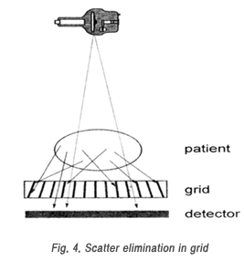
Detector Anti-Scatter Grid
w/o grid
w. grid

Slide 33
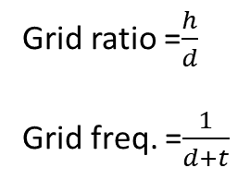
Design of Detector Anti-Scatter Grid
t
Grid ratio =$\frac{h}{d}$
Grid freq. =$\frac{1}{d+t}$
h
d
BF (Bucky Factor)-dose to the patient needs to be increased by a factor BF to keep same x-ray dose incident to the detector w. & w/o detector grid.

